Slide 1
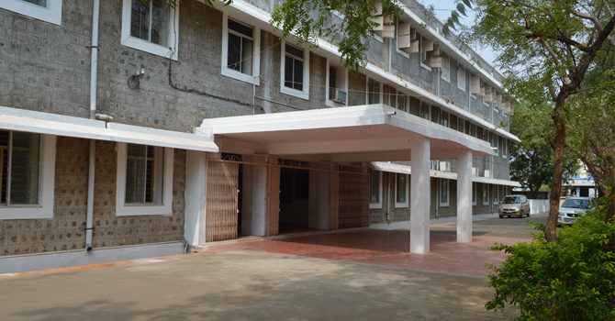

AUTOMATIC MUSIC GENERATION
PRESENTED BY:
NAME : S.SUJITH KUMAR
NM ID : au21MEL03
COLLEGE NAME:M.P.NACHIMUTHU M.JAGANATHAN ENGINEERING COLLEGE
GUIDED BY:
T.ARUN

Slide 2
PROBLEM statement
"In the realm of music composition, the demand for innovative and original pieces is ever-growing, yet the process of manual composition is time-consuming, labor-intensive, and subject to the limitations of human creativity.
Creativity and Authenticity: How can we design algorithms that exhibit genuine creativity and produce music that resonates with human listeners.
Quality Assessment: How can we objectively evaluate the quality and artistic merit of automatically generated music, considering subjective aspects such as emotional impact, coherence, and novelty.
Copyright and Legal Considerations: What are the legal and ethical implications of using automatic music generation systems, particularly concerning copyright infringement and ownership rights over generated compositions?
User Interaction and Adaptability: How can we incorporate user feedback and preferences into the music generation process to create personalized and contextually relevant compositions, tailored to specific applications such as gaming, film scoring, or relaxation therapy?

Slide 3
ABSTRACT
Automatic music generation, driven by advancements in artificial intelligence and computational creativity, represents a revolutionary approach to musical composition. This paper explores the intersection of technology and music, providing an overview of the history, techniques, and future scope of automatic music generation. We delve into the various algorithms and methods employed, including rule-based systems, neural networks, and evolutionary algorithms, highlighting their strengths, limitations, and potential applications. Furthermore, we examine the challenges and opportunities in this burgeoning field, from ensuring creativity and authenticity to addressing ethical and legal considerations. By considering the interdisciplinary nature of automatic music generation and its implications for music production, education, and entertainment, we aim to provide insights into the transformative potential of AI-driven music creation in the digital age.

Slide 4
AIM
The aim of this paper is to provide a comprehensive overview of automatic music generation, exploring its historical development, techniques, and future prospects. By examining the diverse range of algorithms and methods employed in automatic music generation,
we aim to shed light on the opportunities and challenges inherent in this rapidly evolving field. Through an interdisciplinary lens, we seek to foster a deeper understanding of the potential impact of AI-driven music creation on the music industry, artistic expression, and cultural heritage. Ultimately, our aim is to contribute to the ongoing discourse surrounding the intersection of technology and music

Slide 5
OBJECTIVES
Provide a comprehensive overview of automatic music generation, including its historical development and key milestones.
Explore the various techniques and algorithms employed in automatic music generation, such as rule-based systems, neural networks, and evolutionary algorithms.
Examine the strengths, limitations, and potential applications of different automatic music generation methods across diverse domains, including music composition, film scoring, and entertainment.

Slide 6
PROPOSED SYSTEM
Comprehensive Review Platform: Develop a centralized platform for automatic music generation research, compiling historical developments, key techniques, and recent advancements in the field.
Algorithmic Toolbox: Create a repository of algorithms and methods commonly used in automatic music generation, with detailed explanations of their functionalities and implementation.
Application Showcase: Curate a collection of case studies and real-world applications demonstrating the effectiveness and versatility of automatic music generation across various domains, such as film scoring, video game development, and advertising.
Ethical Framework: Establish guidelines and best practices for ethical and responsible use of automatic music generation systems, addressing issues such as copyright infringement, cultural sensitivity, and user privacy.
Interdisciplinary Collaboration Hub: Facilitate collaboration between researchers, musicians, and industry professionals from diverse backgrounds, fostering interdisciplinary dialogue and knowledge exchange.

Slide 7
Components of music generation system
Input data sources
Feature extraction
Model training
Generation and composition process

Slide 8
Techniques and algorithm
Rule-based Systems: These systems use predefined rules and heuristics to generate music. Rules might include musical theory principles such as chord progressions, rhythmic patterns, and melodic structures.
Markov Models: Markov models are probabilistic models that predict the likelihood of future musical events based on the current state. In music generation, Markov models can be trained on a dataset of existing compositions to generate new sequences of notes, chords, or rhythms.
Neural Networks: GANs consist of a generator network that produces music and a discriminator network that evaluates the generated music's quality, leading to more realistic and high-quality output.

Slide 9
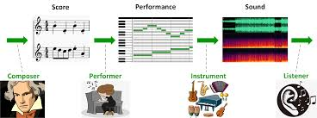
FUTURE SCOPE
Emerging trends and technologies
Potential impact on the music industry
Ethical considerations and societal implications
Enhanced Creativity: Future research will focus on developing algorithms that exhibit even greater levels of creativity and originality in music composition.
Personalization and Adaptability:compositions to individual preferences, contexts, and moods.

Slide 10
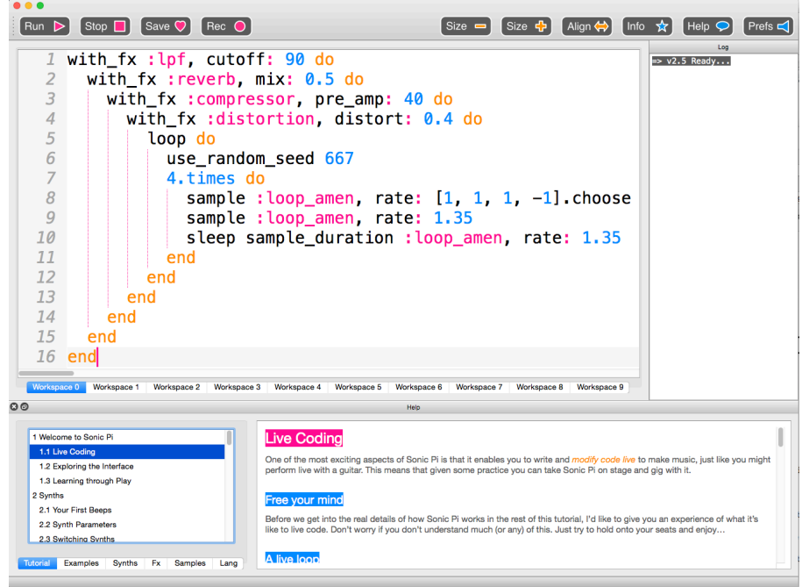

Sonic Pi

Slide 11
BENIFITS
Creativity Assistance: AI-generated music can inspire musicians and composers by providing novel ideas and creative stimuli.
Variety: AI can produce music in various styles and genres, catering to diverse preferences and requirements.
Scalability: AI-powered music generation systems can generate vast amounts of music content rapidly and consistently.
Accessibility: Automatic music generation tools can empower individuals with limited musical training or resources to create music.

Slide 12
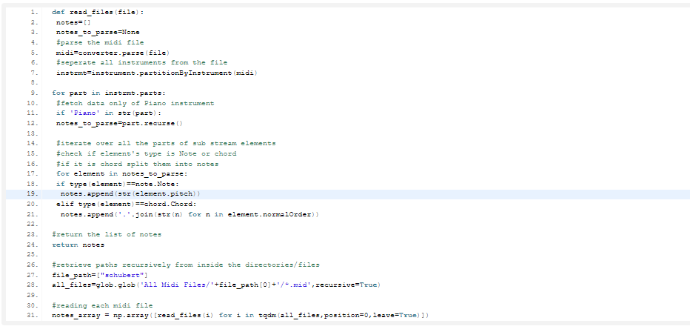
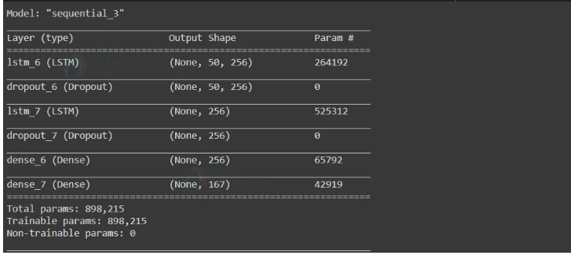
RESULT

Slide 13
conclusion
Recap of key points
Final thoughts on the future of automatic music generation
automatic music generation stands at the forefront of technological innovation
As advancements in machine learning, AI, and computational musicology continue to accelerate
As we embark on this journey of musical exploration
the harmony between human ingenuity and technological prowess, ushering in a new era of musical creativity and discovery.

Slide 14
REFERANCE
Manaris, Bill, Andrew R. Brown, and Blake Stevens. 2016. “JythonMusic: An Environment for Teaching Algorithmic Music Composition, Dynamic Coding, and Musical Performativity.” Journal of Music, Technology and Education 9 (1): 33-56
Nierhaus, Gerhard. 2010. Algorithmic Composition: Paradigms for Automated Music Generation. New York: Springer.
Papert, Seymour. 1980. Mindstorms: Children, Computers, and Powerful Ideas. New York: Basic Books.
Resnick, Mitchel. 1994. Turtles, Termites, and Traffic Jams. Cambridge, MA: The MIT Press.

Slide 15
GIT HUB LINK FOR PROJECT CODE https://github.com/SUJITHKUMAR333/NM-au21MEL03.git

Slide 16

THANK YOU

